Slide 1


COMP 646 – DEEP LEARNING FOR VISION AND LANGUAGE
Caption It: The Ultimate Image Captioning Tool
Members:
Sai Santhosh V C
Tarun Vaseekaran
Elakkiyan Pugazhenthi
Prashithaa Balaji Abirami

Slide 2
PROBLEM STATEMENT
Image captioning models often produce generic or inaccurate descriptions because traditional CNN–RNN architectures struggle with long‐range dependencies and fine‐grained visual details. Fully fine-tuning large vision–language networks can be computationally prohibitive. This work addresses these challenges by integrating a frozen ViT encoder with a GPT-2 decoder through a lightweight MLP bridge and progressive unfreezing, enabling full cross-modal attention at every decoding layer. Performance is evaluated on Flickr8k, comparing frozen and fine-tuned variants across BLEU-4, ROUGE-L, CIDEr, and human-like brevity metrics.

Slide 3
OBJECTIVE AND MOTIVATION
Traditional CNN–RNN captioners often generate generic or incorrect descriptions due to limited context modeling and object-level grounding.
Transformer-based cross‐attention offers fine‐grained vision–language alignment but can be computationally prohibitive when fully fine‐tuned.
Integrate a frozen ViT encoder with GPT-2 via a lightweight MLP bridge and staged unfreezing to enable efficient cross-modal attention without retraining entire networks.
Optimize training (label smoothing, cosine‐decay LR) and decoding (greedy/beam ≤3) to maximize BLEU-4, ROUGE-L, and CIDEr while maintaining concise, human-like captions.

Slide 4
PROPOSED BASELINE SETUP
Dataset: Flickr8k (6 k train, 1 k val, 1 k test)
Vocabulary: 2 984 tokens (freq ≥ 5; includes <pad>, <start>, <end>, <unk>)
Preprocessing: Resize to 224×224, ImageNet normalization, random flips/crops
Baselines: ResNet50+LSTM, MobileNetV3+GRU, Frozen ViT+GPT-2
Model | Loss | Epoch | Batch
ResNet50 + LSTM | 1.28 | 10 | 16
MobileNetV3 + GRU | 1.41 | 10 | 16
ViT + GPT-2 (Frozen) | 1.93 | 3 | 2
Table 1: Final training losses of baseline models on 6k images

Slide 5
EXPERIMENTS
Fine-tuning: Compare frozen vs. fully fine-tuned ViT–GPT-2
Ablations: MLP only, MLP + 2 GPT-2 blocks, Full model
Beam Sweep: Beam sizes {1, 3, 5, 10} for fluency & diversity analysis
Cross-Attention Ablation: With vs. without cross‐modal layers

Slide 6
EX.1 FINE-TUNED MODEL ARCHITECTURE
Frozen ViT-Base
(patch 16)
New 2-layer
MLP Bridge
GPT-2 – 12L
Figure 1: Model architecture of our fine-tuned ViT-GPT-2 model
+2 GPT-2
Blocks
Encoder: Frozen ViT-Base (patch-16) extracts 768-d patch features
MLP Bridge: 2-layer 768→768 projection with tanh + dropout
Decoder: GPT-2 small with cross‐attention in every block
Enhancement: Append 2 extra GPT-2 blocks; staged unfreezing of ViT

Slide 7
FINE-TUNED MODEL RESULTS
Variant | BLEU-4 | CIDEr | Len-R
+ MLP only | 0.056 | 0.279 | 1.70
+ MLP & +2 blocks | 0.065 | 0.316 | 1.63
Full model | 0.074 | 0.350 | 1.55
Table 2: Ablation Study – Additive Gains
Model | BLEU-4 ↑ | ROUGE-L ↑ | CIDEr ↑ | Len-R ↓
Frozen ViT-GPT-2 | 0.033 | 0.234 | 0.158 | 1.94
Fine-tuned | 0.074 | 0.288 | 0.350 | 1.55
Table 3: Test-set scores

Slide 8
EX.2 BEAM SIZE ANALYSIS
Beam | BLEU | ROUGE | CIDEr | log p | D-1 | D-2
1 | 0.042 | 0.101 | 0.0175 | –0.02 | 0.0007 | 0.0008
3 | 0.016 | 0.065 | 0.0016 | –0.02 | 0.0005 | 0.0006
5 | 0.026 | 0.055 | 0.0042 | –0.02 | 0.0014 | 0.0023
10 | 0.005 | 0.000 | 0.0004 | –0.02 | 0.0006 | 0.0012
Table 4: Beam-size vs Metrics
Greedy decoding (beam=1) achieves the highest overlap scores (BLEU-4, ROUGE-L, CIDEr) and fluency.
Diversity (Distinct-2) peaks at beam=5, but large beams (≥10) collapse into generic captions.
Small beams (≤3) strike the best balance between accuracy, fluency, and variety.

Slide 9
EX.3 CROSS ATTENTION VS NO CROSS-ATTENTION RESULTS
Metric | Cross-Attention | No Cross-Attention
BLEU-4 | 0.158 | 0.034
METEOR | 0.483 | 0.254
ROUGE-L | 0.357 | 0.223
BERTScore | 0.908 | 0.874
CIDEr | 0.065 | 0.002
Table 5: Metrics show large drops when cross-attention is removed
All-round performance drop: Removing cross-attention slashes BLEU-4 by 78 % and CIDEr by 97 %, indicating severe loss of grounded image information.
Semantic alignment: METEOR, ROUGE-L, and BERTScore all decline substantially without cross-attention, showing captions revert to generic language patterns.

Slide 10
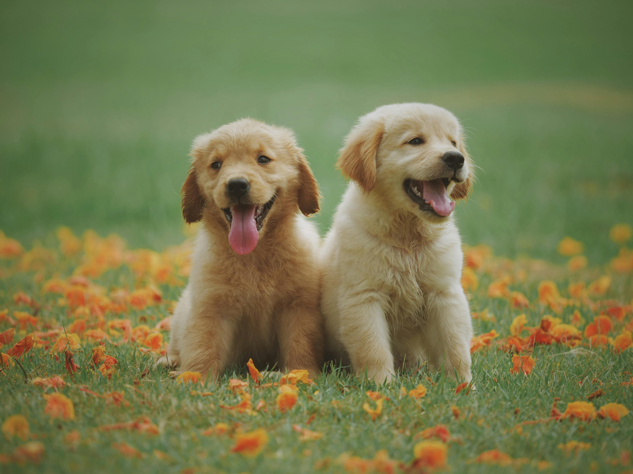


SAMPLE MODEL OUTPUT
A yellow dog runs through grass with its tongue hanging out.
A person is standing in front of a golden retriever in a field.
A girl in a pink hat takes a picture with a digital cam era

Slide 11


